Slide 1



CloUD Infrastructure FINAL PROJECT Carlos Oliveira Mohan Kumar

Slide 2
Why AWS?
Key differences between aws and azure
Basic infrastructure
Scope of work
terraform
ansible
7. Docker
8. Kubernetes
9.ConCLusion

Slide 3
1. WHY AWS?
It Has Been Around the Longest
Amazon introduced the world to Amazon Web Services in 2006
The biggest cloud provider
AWS has more than ten times the computing capacity of the next 14 largest infrastructure vendors combined.” AWS has multiple data centers located across the globe. As it stands, AWS has 33Availability Zones within 12 cloud regions.

Slide 4
2. KEY DIFFERENCES BETWEEN AWS AND AZURE
Azure is open to Hybrid cloud systems whereas AWS is less open to private or third-party cloud providers.
AWS follows pay as you go and they charge per hour whereas Azure also follows pay as you go model and they charge per minute which provides more exact pricing model than AWS.
AWS has more features and configurations and it offers a lot of flexibility, power, and customization with support for many third party tools integration. Whereas Azure will be easy to use if we are familiar with windows as it is a windows platform and it’s easy to integrate on-premises windows servers with cloud instances to create a hybrid environment.
Source: https://www.educba.com/aws-vs-azure

Slide 5
3. BASIC INFRASTRUCTURE
Preferred Cloud Platform - Amazon Web Service (AWS)
Terraform tool to automate the deployment of Virtual Machines.
Ansible is a radically simple IT automation engine that automates cloud provisioning, configuration management, application deployment, intra-service orchestration, and many other IT needs.
Github is a code hosting platform for version control and collaboration. It lets you and others work together on projects from anywhere.
Docker is an open platform for developing, shipping, and running applications. it enables an isolations between applications and the infrastructure and consequently it is possible to deliver software quickly with Docker.

Slide 6
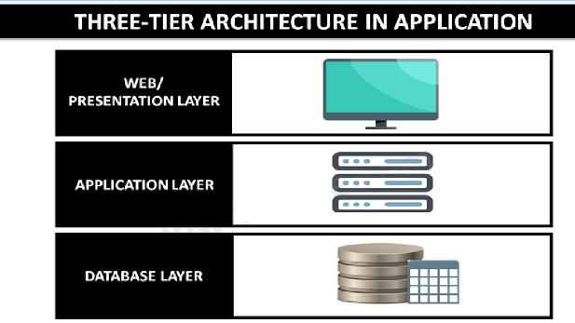
4. SCOPE OF WORK
Development Infrastructure:
Webserver machine, its job is to establish a connection between a server and the browsers of website visitors (Firefox, Google Chrome, Safari, etc.) while delivering files back and forth between them (client-server structure).
App Server machine, is designed to install, operate and host applications and associated services for end users, IT services and organizations and facilitates the hosting and delivery of high-end consumer or business applications
Database machine, a database and a program for managing read and write access to a database. This tier may also be referred to as the storage tier and can be hosted on-premises or in the cloud
Production Infrastructure:
A Kubernetes cluster composed of a master and three worker nodes on which the containerized application is deployed

Slide 7
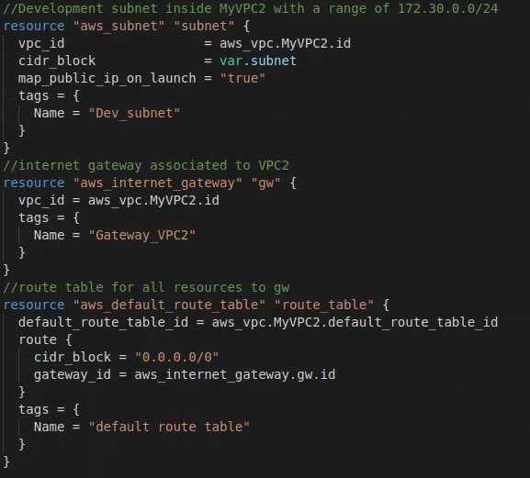
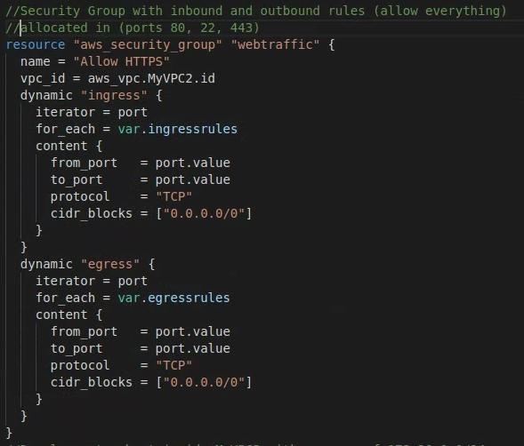
5. TERRAFORM
Configuration of the Network for the deployment of the instances

Slide 8
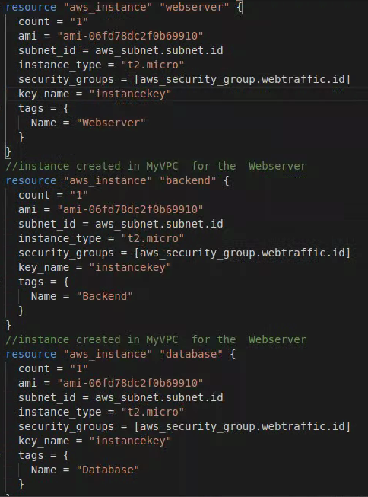
5. TERRAFORM (Continued)
SYNTAX FOR DEPLOYMENT OF MACHINES
Deployment of the three machines.

Slide 9
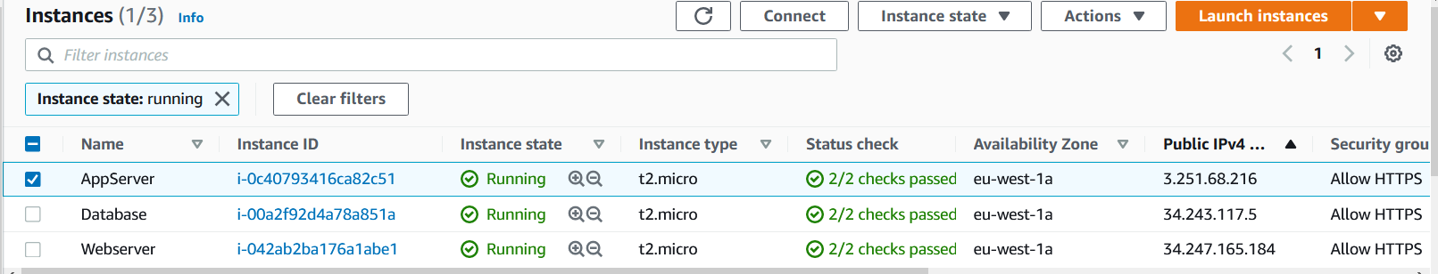
5. TERRAFORM (Continued)
Three servers deployed by Terraform to AWS

Slide 10
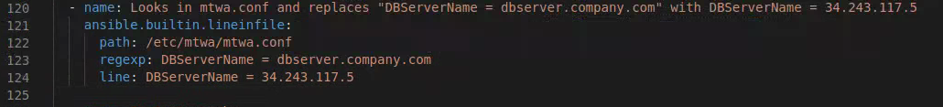

6. ANSIBLE
Two playbooks were utilised to deploy the infrastructure:
Playbook 1 - Webserver and Appserver;
Playbook 2 - Database Server;
Main tasks used for deployment:
The following Syntax looks into a specified path and replaces an expression/word with a desired one:
Downloads a git repository and stores it in a desired directory:

Slide 11
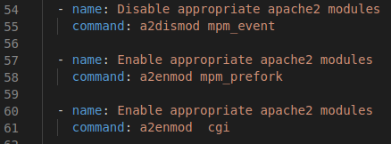

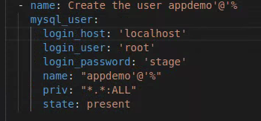
6. ANSIBLE (Continued)
Enable/disable apache2 modules
Download a file from an URLl link into a specified directory
Creation of an user in MySQL database:

Slide 12
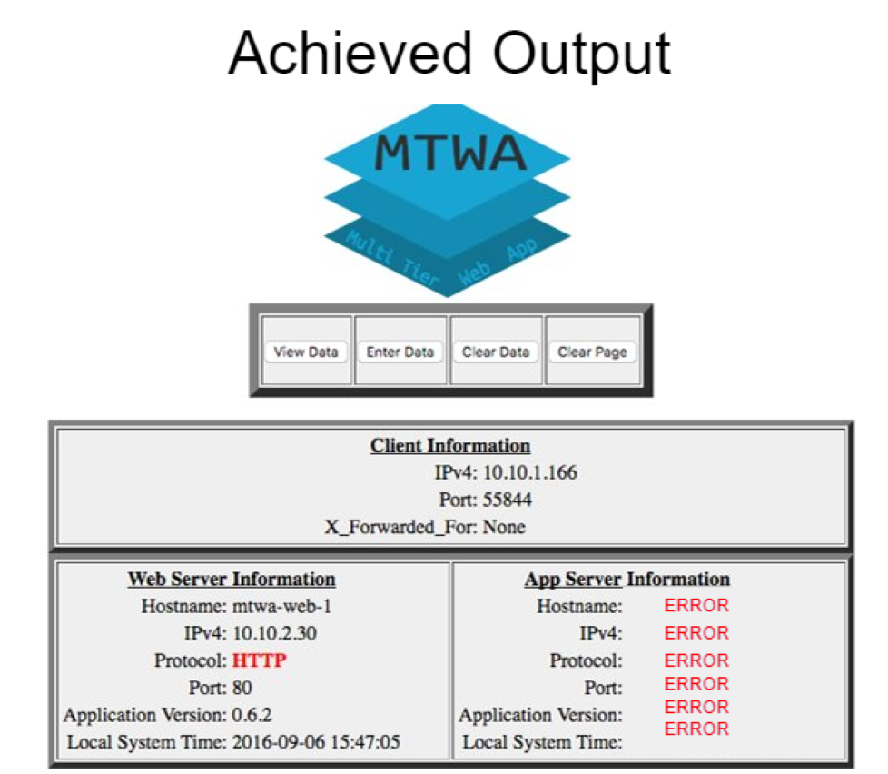
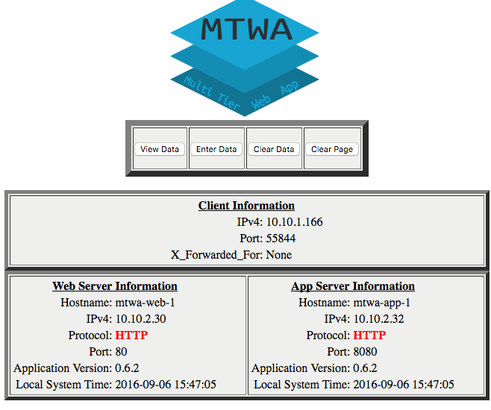
6. ANSIBLE (Continued)
Three Tier APP User Interface Webpage:
Desired Output

Slide 13
7. DOCKER
Deploy the Three tier application with an isolated environment (3 containers), webserver and appserver will be connected beteween each other and also connected to the internet while the database server will be connected only to the appserver without internet connection
Internet
Docker Image
Container
Webserver
Docker Image
Docker Compose
Container
AppServer
Docker Image
Container
Database Server

Slide 14
8.Kubernetes
Worker Node
Worker Nodes run the containers of your application
Cluster
Proxy / Config
Master Node
Pod (Container)
Various Components which help with managing the Worker Nodes
Worker Node
“Nodes” are your machines / virtual instances
Cloud Provider API
Proxy / Config
Pod (Container)
The Control Panel
Worker Node
Multiple Pods can be created and removed to scale your app
The Master Node controls your deployment (i.e. all Worker Nodes)
Proxy / Config
Pod (Container)

Slide 15
Any Questions?

Slide 16
THANK YOU

